Slide 1
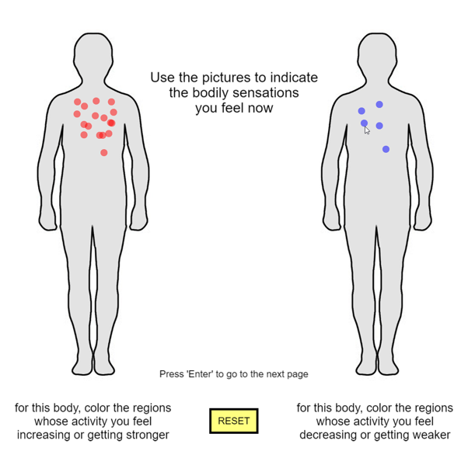
Sometimes you will be asked about bodily sensations you feel during experiment
You can mark the change of your bodily sensation by mouse click on the body picture
In the left body, you can check the regions whose activity you feel increasing or getting stronger. It will be marked as a red circle.
In the right body, you can check the regions whose activity you feel decreasing or getting weaker. It will be marked as a blue circle.
If you press SPACE BAR, the marking will RESET and you can restart marking.
If you finish marking, press ENTER key
Mark using
mouse click!!
Press ENTER to finish!
Press ‘Space bar’ to continue
Previous page
Next page

